Slide 1

Introduction to FIX
Domain Consulting Group
Date: April 2007

Slide 2

Overview
Financial Information / Messaging: Who? What? How? Why?
What is FIX
Why FIX so popular?
FIX systems and connectivity
FIX – Typical message flows
FIX Communication – Message Structure and Syntax
FIX examples - Business Scenarios
Examples

Slide 3
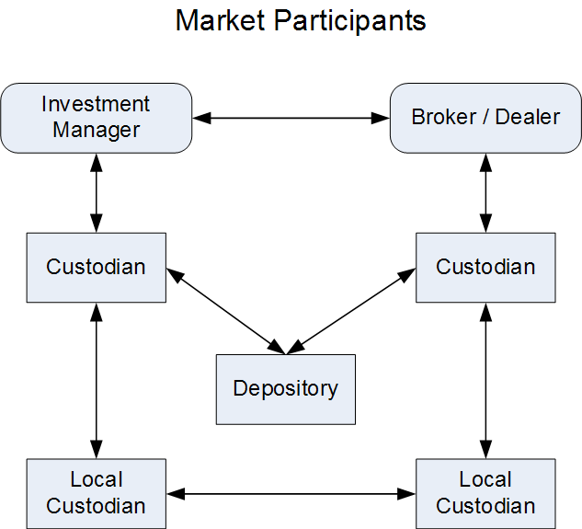
Financial Information/ Messaging: Who, What?
Who uses? : Market Participants
  During Trade Cycle
What information is exchanged ?
  Broker Research Reports
  Pre-Trade -IOIs, Advts, Quotes, News
  Trade - Orders, Confirmations, Fills
  Post-Trade- Allocations, Settlement Instructions
  Clearing/Settlement - Back-offices to custodians

Slide 4
Financial Information/ Messaging – How?
Broker Research: Research Reports
  Paper, Web-sites, Vendor systems, RIXML
Pre-Trade: IOIs, Advertisements, Quotes, News
  Phone calls, FIX, Vendor systems, Fax
Trade: Orders, Confirmations, Fills
  Phone calls, FIX, Vendor systems
Post-Trade: Allocations, Settlement Inst
  Vendor systems, Fax, FIX
Clearing/Settlement: Back offices to custodians
  Vendor systems, Fax, ISO 15022 (SWIFT)
Notes:
The communications that are made by various market participants like Investment manager, Broker/Dealers, Custodians and depositories use various channels. Some of the channels used are traditional channels like phone and fax.
In the recent past the usage of standards like FIX and SWIFT have increased for certain trade and post trade communications though traditional channels still continue to be in use.

Slide 5
Financial Information/ Messaging – Why?
Need for Financial Messaging standard
  Real-time exchange of information
  Standard way of communication – Common language
  Common set of functionalities
  Uniform technology infrastructure

Slide 6
Why FIX is popular?
Technical Reasons
  Real-time information Delivery
  Provides platform and vendor independence
  Guarantees ordered message delivery
  Supports data security (encryption)
  Supports multiple currencies and instrument types
  Allows for cost-effective connectivity
  Eliminates proprietary interfaces and coding of multiple message formats reducing amount of time to connect
  Reduces amount of time to connect
Business Reasons
  Accommodates higher volumes
  Widely adopted
  Enables front to back STP
  Increasingly diverse content –IOI’s, advertisements, news notices
  Prepares firms for shortened settlement cycles
  Allocation and settlement improvements
  Responds quickly to industry changes
  Leverages the active participation of industry experts via working groups
  Productivity gains –reduces operational errors

Slide 7
What is FIX?
Simply put - Financial Information eXchange
A written public-domain specification of what and how to communicate
A specification that defines types of electronic messages for trading securities between two parties
FIX is NOT a: | Rather FIX is:
Software Hardware Network Trading system, exchange, or market Programming language | Enabling technology for Electronic Trading Each new version adds capability Governs connectivity and content Market participants -driven messaging standard (Firms, Exchanges, ECNs, Technology vendors) Invented FIX to solve specific business needs Suggest changes to FIX and use to run their businesses Responsible for maintaining and promoting the spec

Slide 8

More on -What is FIX?
Asset Classes supported
  Equities
  Derivatives
  Fixed Income
  Foreign Exchange
Versions of FIX protocols: Starting 4.0, 4.1… till 5.0 (latest)
  Each version has improved coverage of Business Functionality
  No. of tags have increased in every newer version
  FIX Functionality Matrix: Functionalities are supported in each version
    Here it is:

Slide 9
More on -What is FIX?
Messages are
  Text-based, but in “tag = value” or FIXML format
    Tag/Value Example: “40 = 4” means “Stop Limit” type of order
    FIXML Example: <OrdTyp>4</OrdTyp>
Common vocabulary examples:
  “AvgPx” means “average price”
  “MsgType” means “Message Type”
  “CxlQty” means “Cancelled order Quantity”
  “ClOrdId” means “Client Order ID”

Slide 10
What is a FIX Message?
A series of ‘tag=value’ pairs
Two types of message: Session and Application Layer
Each layer carries stream of messages
Each message has certain ‘purpose’
Each Message contains three parts: Header, Body and Trailer

Slide 11
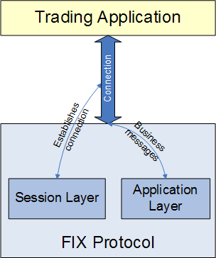
Type of message: FIX layers
Session Layer
  Establishing and terminating the connection
  It manages message delivery, data integrity, sequencing and addressing
  Example – Logon, Logout, Heartbeat, etc
Application Layer
  Comes into effect once connection is established
  Responsible for business related content
  Order, Execution, IOI, etc
  Example – New order single, Order cancel / replace

Slide 12
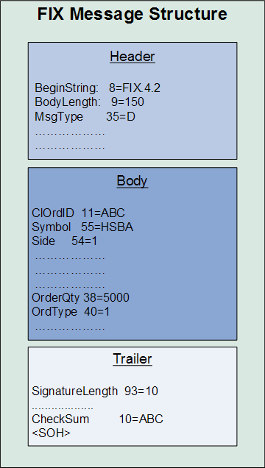
FIX message structure
Example:
New Order – “NewOrderSingle” Message
Message Header
  Contains information about Message type, length, Sender/destination, sequence number, sending time, etc
  Example – SenderID, MsgType, etc
Message Body
  Specific session and application layer content
  Example – Order, execution details
Message Trailer
  Contains optional digital signature and checksum values
  Example – CheckSum, Signature

Slide 13
FIXML: What is it?
FIX + XML = FIXML
FIXML is another, more structured way to format the FIX business messages.
XML introduces structure into the application message.
  E.g. things like repeating groups of related fields, this is very helpful.
FIXML is as a FIXML message enveloped in XmlData field (tag 213 ) of standard FIX message
An example will help you here… (next slide)

Slide 14
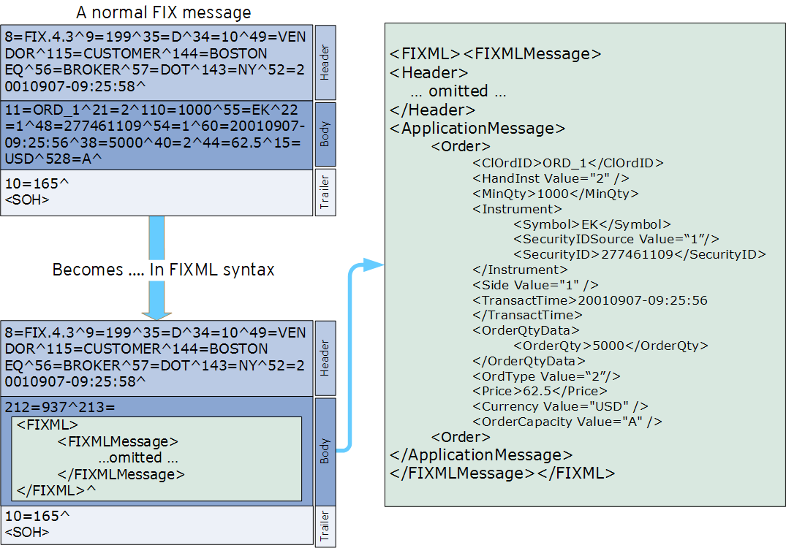
FIXML – Example message

Slide 15







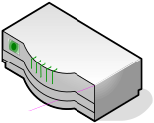

FIX– typical setup
Sell-side OMS
Buy-side OMS Trading System
Buy-side FIX Engine
Sell-side FIX Engine
Sell-side Application / Gateway
Stock Exchange
Two variants of FIX Setup
  Multiple brokers
  Hub & Spoke
Explained on next 2 slides

Slide 16
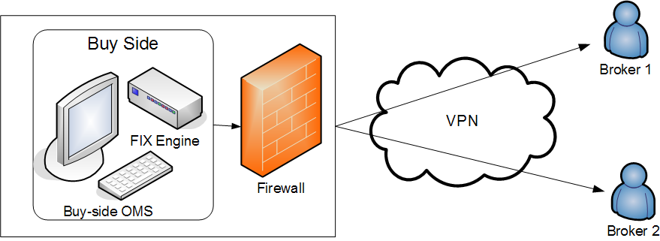
FIX systems: Point-to-Point
A buy-side OMS (+ FIX Engine) connects to multiple brokers
A Firewall and Virtual Private Network is used
FIX engine is embedded in the OMS system
FIX engine provides the FIX validation, message construction
Firewall provides the protection

Slide 17
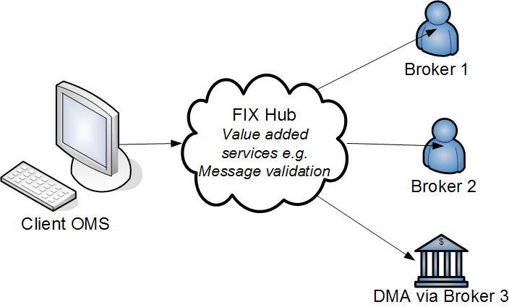
FIX Systems: Hub & Spoke arrangement
OMS uses single connection to connect to multiple counterparties
FIX Hub provides connectivity to Brokers and other Counterparties

Slide 18
FIX System connectivity
Customer (i.e. Investment Mgr)
Supplier (i.e. Broker/Dealer)
FIX System
FIX System
Wide Area Network Link
Business Msg Processing
FIX Engine
FIX Engine
Business Msg Processing
TCP/IP
(TCP Socket opened by customer, persists during life of FIX session)
Business Msg Processing
Business Msg Processing
Order Management System
Order Management System
Trader
Trader
Trader
Trader
Trader
Trader

Slide 19
What is a FIX Engine anyway ?
A piece of software that:
  Manages a network connection,
  Creates and parses outgoing and incoming messages, respectively, and
  Recovers if something goes wrong
A FIX engine manages the session and application layers
Only piece of software one needs in order to ‘FIX-enable’ trading or order management systems
In Summary: an interface to the outside world that allows you to trade and exchange relevant information in a standard fashion

Slide 20
Typical trading day with FIX
A trading day in FIX involves the following
  Pre connection
  Establishment of connection (Session layer)
  FIX message flow (Application layer)
    Indications of Interest
    Orders/Execution Reports
    Allocations
  End of connection and end of day processing (Session layer)

Slide 21
Session Level messages
Initiating a session (Logon)
Heartbeat
Message Sequencing
Message Validation
Ending a session (Logout)

Slide 22
Initiating a Session
Logon: MsgType=A (i.e. 35=“A”)
Buy side firm initiates (the Initiator) a connection to a Sell side (the Acceptor) firm using the LOGON Session Level Message
  8=FIX.4.2^
  9=92^
  35=A^
  49=BOFASEC0^
  56=DFIX201^
  50=MSO:MSO^
  57=TEST^
  34=106^
  43=N^
  52=20010822-13:06:42^
  98=0^
  108=30^
  10=021^

Slide 23
Login Scenario: Start of the day
Request Initiator (M001)
Login MsgType=A, TargetCompID=FIX001
SenderCompID=M001 MsgSeqNum=1
Request Recipient
(FIX001)
Valid SenderCompID;
Incoming Sequence Number matches expected value
This is the
Logon
Acknowledgement
Login MsgType=A, TargetCompID=M001
SenderCompID=FIX001 MsgSeqNum=1
Incoming Sequence Number matches expected value
We have a FIX Session Established!

Slide 24
Resend Request (MsgType=2)
Used to request the counterparty to resend a set of FIX messages
Tell the counterparty the range of messages that you did not receive
  BeginSeqNo (tag 7)
  EndSeqNo (tag 16)

Slide 25
Heartbeat
To let each side that connection is alive
The FIX Session is kept alive by both sides sending heartbeats to the each other:
    8=FIX.4.2^
    9=0072^
    35=0^
    49=GLTRADE1^
    56=DFIX201^
    34=2^
    52=20010822-13:53:28^
    10=124^

Slide 26
Heartbeat - Scenario
Session Initiator
Login MsgType=A TargetCompID=CBOEFIX001
SenderCompID=M001 MsgSeqNum=1
Session Acceptor
Login MsgType=A TargetCompID=M001
SenderCompID=CBOEFIX001 MsgSeqNum=1
Heartbeat MsgType=0 TargetCompID=CBOEFIX001
SenderCompID=M001 MsgSeqNum=2
Heartbeat MsgType=0 TargetCompID=M001
SenderCompID=CBOEFIX001 MsgSeqNum=2
Logout MsgType=5 TargetCompID=CBEOFIX001
SenderCompID=M001 MsgSeqNum=1

Slide 27
Test Request Scenario
Test Request Initiator
Test Request Recipient
Test Request MsgType=1, TestReqID=“AnyString”
Heartbeat MsgType=0, TestReqID=“AnyString”

Slide 28
Ending a Session: Logout
Once the day’s message communication is over, FIX sessions are ended
To end a session, use Logout Message (i.e. 35=5)
Each side sends a logout message
    8=FIX.4.2^
    9=0082^
    35=5^
    49=DFIX201^
    56=GLTRADE0^
    34=483^
    52=20010822-14:05:34^
    10=176^

Slide 29
Normal Logout Processing
Firm Initiating Logout
Logout Recipient
Logout MsgType=5 TargetCompID=FIX001
SenderCompID=M001 MsgSeqNum=M
It is considered bad form to close the connection prior to receiving the logout confirmation
Wait a brief period of time (heartbeat interval) for other side to send logout – this is done in case other side needs to do resend processing
Logout MsgType=5 TargetCompID=M001
SenderCompID=FIX001 MsgSeqNum=N
Both sides disconnect by closing socket

Slide 30
Message Sequencing
The FIX Session guarantees that messages are delivered in the order in which they are sent
A FIX Session can be defined as: “a bi-directional stream of ordered messages between two parties within a continuous sequence number series”
Each FIX Engines is expected to keep track of two sequence numbers
  The Incoming Sequence Number expected on inbound messages received from the counterparty
  The Outgoing Sequence Number to be sent to the counterparty

Slide 31
Message Sequencing
So what happens if the sequence numbers are not in order?
FIX Provides messages for recovery of lost messages
  Provides for delivery of lost messages
  Provides for a way to resynchronize sequence numbers between engines

Slide 32
Message Validation
FIX Engines validate that messages are properly formed and will reject the message using a Session Level REJECT message if the message is invalid
The Checksum (tag 10) is validated

Slide 33
Application Level messages
Pre-trade
  IOIs
  Advertisements
Trade
  Orders : New, Amend (Cancel / replace), Execution reports, DFDs
Post trade
  Allocations, Confirmations,

Slide 34









FIX Order Flow
Investment Manager, QFII or Domestic
Broker/Dealer
(1) IOIs & Advertisements
(2) Order
(3) Order Confirm
(4) Don’t Know Trade
(5.1) Execution Rpt (Partials)
(5.2) Execution Rpt (Partials)
(5.3) Execution Rpt (Partials)
(6) Done for the Day (DFD)

Slide 35
FIX – Example of a typical scenario
Next few slides illustrate a Business Scenario (all executed through FIX messages)
  Customer “A” wants to sell some shares. He sends a Sell order to broker
  Broker accepts this order
  Broker indicates availability of Sell order on FIX network
  A customer “B” wants to buy the same shares and responds to IOI by sending a FIX Buy order
  Broker accepts this Buy order
  Broker sends Executions to Customer A and B using Execution reports

Slide 36


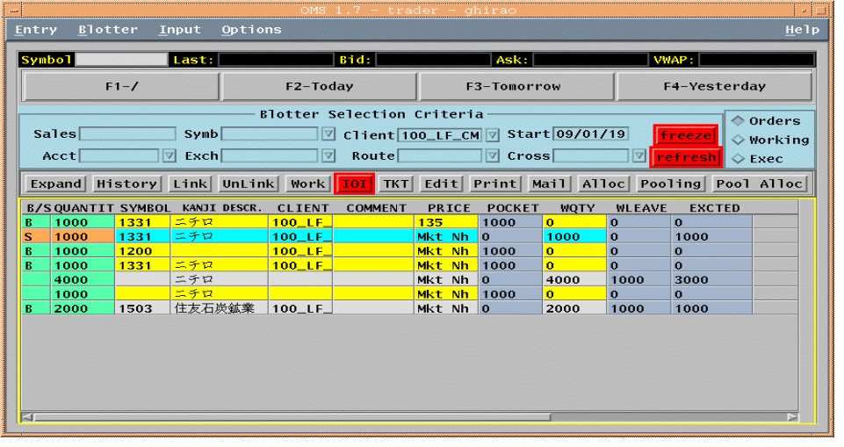
FIX Customer/Broker Example
Step 1 - Customer A’s Order
FIX Order
Symbol = 0001.HK, Side = Sell, OrderQty = 1000, OrdType = Market
[35=D;55=0001.HK;54=2;38=1000;40=1]
Broker
Sell
1000
Cheung Kong
Accept Sell
1000
Cheung Kong
Customer A
FIX Order Accept (Execution Report)
Symbol = 0001.HK
Side = Sell
OrderQty = 1000, OrdType = Market
OrdStatus = New
[35=8;55=0001.HK;54=2;38=1000;40=1;39=0]

Slide 37


FIX Customer/Broker Example
Step 2 – Sending an IOI
FIX Network
Seller of
1000
Cheung Kong
Broker/
Position Trader
Customers
FIX IOI
Symbol = 0001.HK
Side = Sell
IOIShares = 1000
Price = 101
IOINaturalFlag = Y
[35=6;55=0001.HK;54=2;27=1000;44=101;130=Y;]

Slide 38
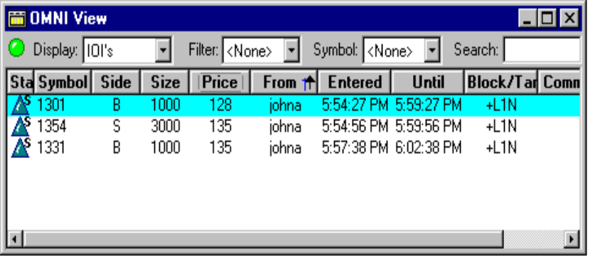
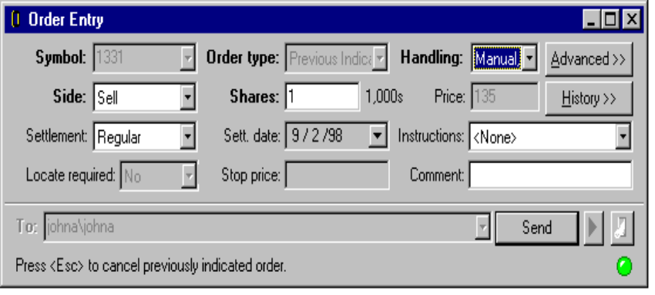
FIX Customer/Broker Example
Step 3 - Filter IOIs, Cust B’s Order
FIX Order
Symbol = 0001.HK
Side = Buy
OrderQty = 1000
OrdType = Market
[35=D;55=0001.HK;54=1;38=1000;40=1]
Buy 1000
Cheung Kong
Accept Buy 1000
Cheung Kong
Broker/
Sales Trader
Customer B
FIX Order Accept (Execution Report)
Symbol = 0001.HK
Side = Buy
OrderQty = 1000, OrdType = Market
OrdStatus = New
[35=8;55=0001.HK;54=1;38=1000;40=1;39=0]

Slide 39
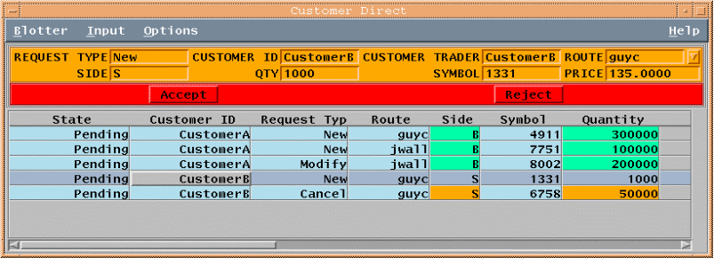


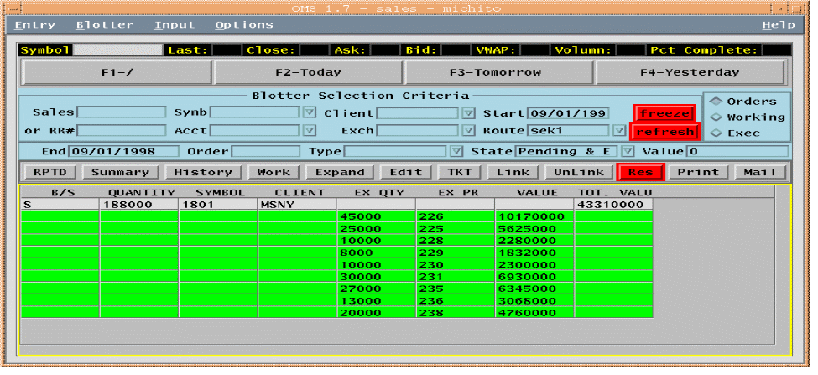
FIX Customer/Broker Example
Step 4 - Traded, Execution Rpts
FIX Execution Report (Filled)
Symbol = 0001.HK, Side = Buy, OrderQty = 1000,
OrdStatus = Filled, LastShares=1000, LastPx=101
[35=8;55=0001.HK;54=1;38=1000;39=2;32=1000;31=101]
Bought 1000
Cheung Kong
Customer B
Broker
Sales Trader
Sold 1000
Cheung Kong
Customer A
FIX Execution Report (Filled)
Symbol = 0001.HK, Side = Sell, OrderQty = 1000,
OrdStatus = Filled, LastShares=1000, LastPx=101
[35=8;55=0001.HK;54=2;38=1000;39=2;32=1000;31=101]

Slide 40




FIX Post-trade flow
Investment
Manager, QFII or Domestic
Broker/Dealer
Booking & Allocation (Breakdowns)
Allocation Ack (Received)
Block-level Accept
Confirmation
Confirmation
Confirmation
Affirmation
Affirmation
Affirmation
Settlement Notification to Agents/Custodians
Notes:
Settlement Instructions may be standing, exchanged during or after allocation process, or one firm can send instructions for both sides for the other firm to match

Slide 41
Exchange preferred message flow
Order
Order Confirm
Execution Rpt (Partials)
Execution Rpt (Partials)
Execution Rpt (Partials)
Done for the Day
Exchange

Slide 42
FIX – Knowledge Repository
FIX protocol Portal http://www.fixprotocol.org
  Contains specifications, Implementation Guides and Discussion forums
  FIXimate (4.0, 4.1… 5.0): Specifications
Transacttools : http://www.transacttools.net/ttportal/datadict/browser.jsp
  Contains easy to browse specifications

Slide 43
Do you have any Questions?
Thank you !

